Slide 1
Needle wound 9/6 motor w/ 2-step Skewed Rotor : Few Design Variants
11/12/2014

Slide 2
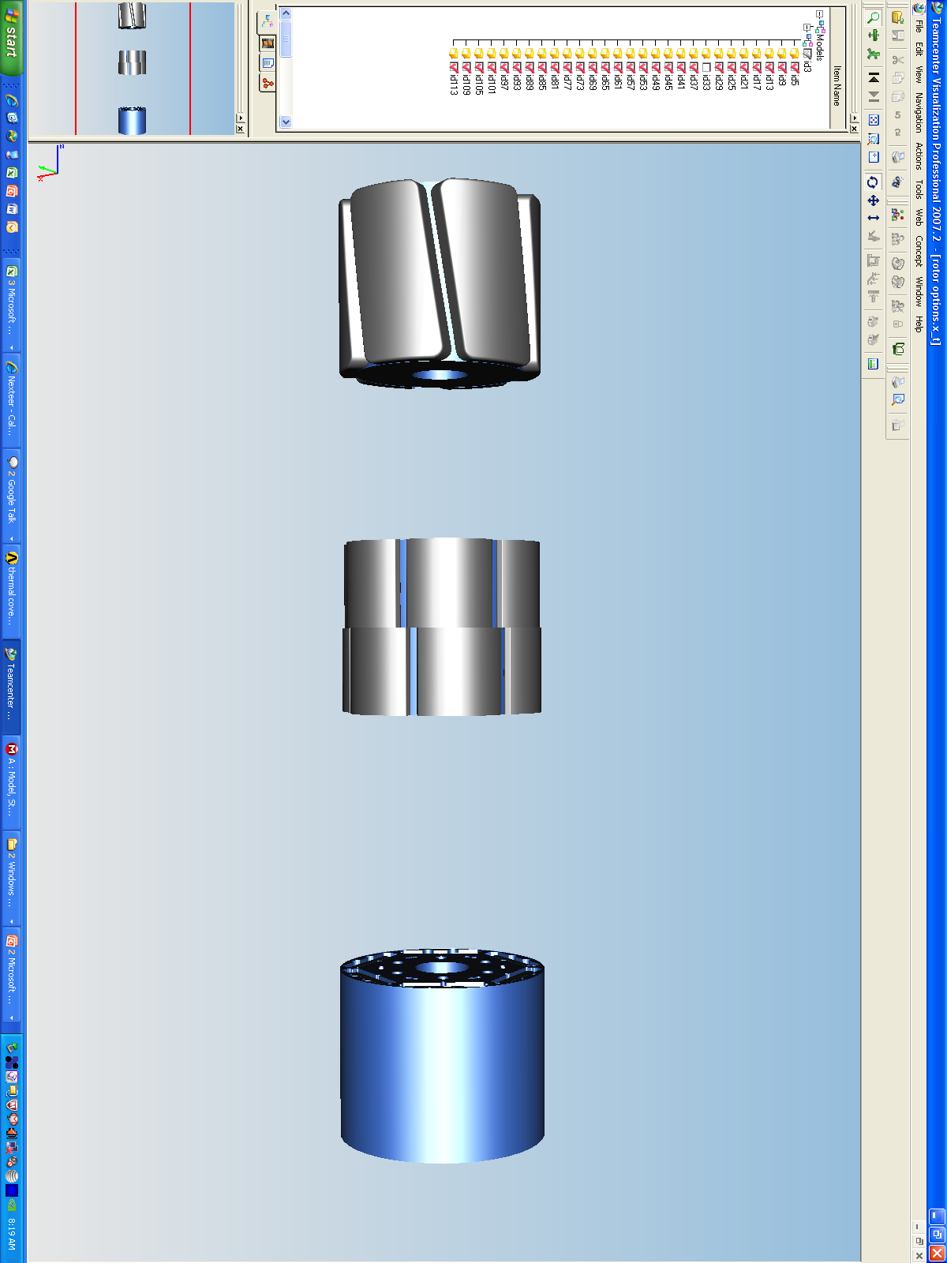
Effect of Skew Angle w/ 2-step skew
P-P Cogging vs skew angle
Each order with equal amplitude assumed (9th,18th,27th, $ 36th )
Optimum skew angle is a function of the cogging order
Less skew needed for minimizing higher order cogging
Cogging torque more sensitive with lower value of optimum skew angle

Slide 3
Representative PSA / BEV Motor
P-P Cogging vs skew angle
Each order comes with different amplitude
100% reduction of 18th and 0% reduction on 36th was selected for skew
PP cogging would be much higher for 100% reduction in 36th
PP cogging is also higher for 69% reduction in 36th and 41% reduction in 18th

Slide 4
Representative PSA/BEV Motor : Effect on Lstk
9th and 27th order had very low contribution
18th and 36th orders are the main contributors
Balance between 18th and 36th order cancellation is the key to minimize overall cogging torque

Slide 5
Representative PSA/BEV Motor : BEMF Harmonics
Minimum harmonics (combined all orders) around 8 to 9 deg skew
Sensitivity of 7th order harmonics higher than all other orders
Accuracy of % harmonics is within 0.1%~0.2%

Slide 6
Summary
Minimum cogging at 10 deg skew
Minimum harmonics (between 8 and 9 deg skew)
Ke loss could be compromised around 8 to 9 deg skew

Slide 7
BACK UP SLIDES

Slide 8
Background of R1=R2, 2-Step Skewed Design
Improved magnet yield / utilization compared to pole shaped design
Can reduce motor stack length for a particular torque requirement
Reduced air-gap and uniform magnet thickness compared to pole shaped magnet
Improved demagnetization
Potential to reduce HRE (Dy, Tb etc)
Less number of magnets compared to pole shaped 3-step skew
Reduce some variability on magnet dimensions and placement
Potential design options for smaller motor lengths when 3-step skew is challenging
Requires active cancellation for cogging torque, may require ripple cancellation too
PSA, BEV, FIASA, VSS –potential programs at hand

Slide 9
Study on a 30 mm Long Motor
Pole Shaped Magnet w/ traditional tooth design
Pole shaping factor varies from 0.7 ~ 1.116
Both cogging torque and BEMF analyzed

Slide 10

Cogging Torque : Different Pole Shaping
a
b
Component cancelled w/ 2-step skew
R1=R2, 2step skewed design
Pole shaping factor = a/b

Slide 11
BEMF and Ke : Different Pole Shaping
Components reduced w/ 2-step skew

Slide 12
Cogging Torque Sensitivity
Existing design

Slide 13
Study on a 30 mm Long Motor-Contd.
Combining Pole Shaped Magnet w/ Tooth Shaped Stator
Pole shaping factor varies within 1.0 & 1.116
3-different design analyzed for both cogging torque and BEMF
Tooth shape
Tooth shape-1
Tooth shape-2
R1=R2 (pole shaping factor=1.0)
Straight faced tooth
R1=R2 (pole shaping factor=1.0)
Reverse arc tooth
Pole shaping factor=1.116)
Reverse arc tooth

Slide 14
Cogging Torque Sensitivity

Slide 15
BEMF Harmonics Sensitivity
Very comparable alternate options
More design iterations needed to finalize on tooth shaped options

Slide 16
Current Design vs. Alternate Options -Comparison

Slide 17
Current Design vs. Alternate Options - Comparison (contd.)

Slide 18
Some Competition Data – (under development)

Slide 19
Motor with P-P Cogging of 50 mNm
P-P Cogging vs skew angle
Each order with different amplitude assumed (9th, 18th, 27th & 36th )
Optimum skew angle is not a function of the cogging amplitude
Optimum skew angle for a particular order might not be adequate to minimize other orders present
Prioritization is essential to choose skew angle and the order to minimize
Skew angle can reduce:
All but 18th
9th and 18th
All orders

Slide 20
Motor with P-P Cogging of 50 mNm
P-P Cogging vs skew angle
Each order with equal amplitude assumed (all orders present)
Skew angle with lowest cogging torque minimizes all orders to a great extent
Not enough compensation for lower orders around 6 deg of skew

Slide 21
Motor with P-P Cogging of 50 ~ 60 mNm
P-P Cogging vs skew angle
Each order with different amplitude assumed (all orders present)
Minimum cogging is for skew angle of 6 ~ 10 degrees
Least cogging amplitude is around 10 deg skew (100% reduction in 18th )
No phase information accounted for

Slide 22
Representative PSA/BEV Motor : Effect on Lstk
Minimum cogging torque around 50 mNm
Ke loss (stack reduction from no skew) around 3.5%

